Slide 1
IMPLEMETATION OF LDPC AND PRODUCT CODES

Slide 2
Technical Introduction
Problem statement- Logic for code and graph itself is harder to understand and implement. Simulations taken for graph are tedious and time taking.
The code takes a large amount of memory, so the computations become very slow. The code is a bit complex so it is frequent to get lost in between and lose the link.
Motivation- Motivation for us to do this project was to learn about new things in communication systems like the product and LDPC codes, BEC and BSC channels etc. and to improve our coding skills.

Slide 3
Project Description
Objectives:
Our first objective for this project was to develope a working program code which can work for both types of codes-the LDPC and product codes simultaneously.
Observations and Results:
From the graphical analysis, we tried to know the changing trends on changing error probability, number of message bits and parity bits.

Slide 4
Channel Encoding And Decoding
Channel Encoding-
The channel encoder adds redundant bits to the message signal. Now along with the original message bit we have other bits so that the received signal is quite long and can be decoded efficiently.
Channel Decoding-
Performs channel decoding which is usually the reverse process of channel encoding. It is the process of translating received messages back into codewords of original code. It is usually used to recover messages sent over noisy channels.

Slide 5
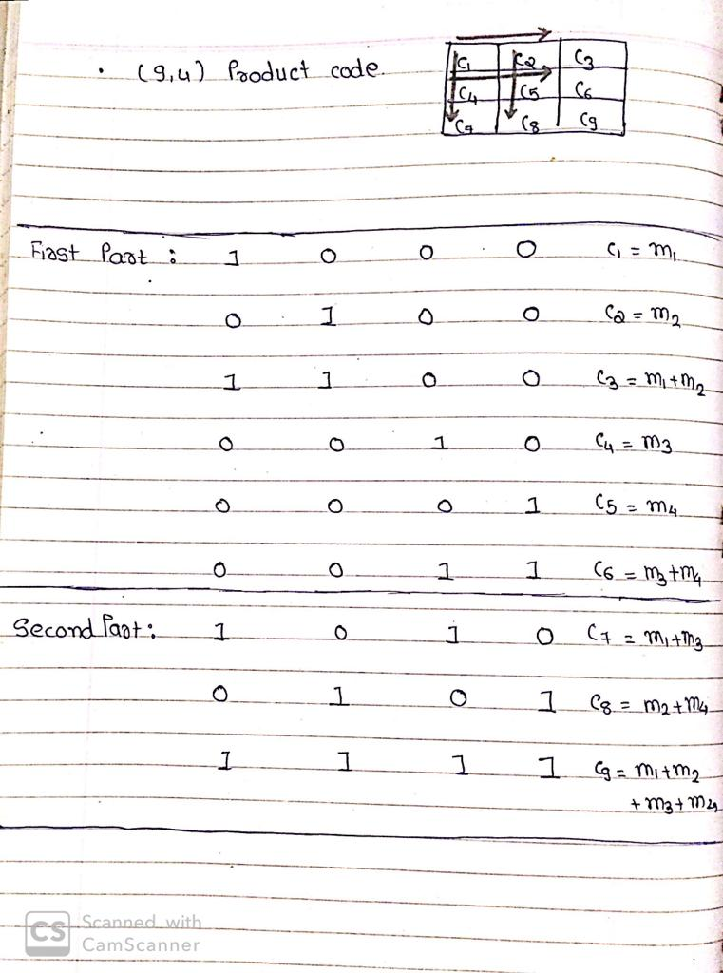
Generator matrix (for product code)
Take input k from the user. Finding the value of n=(sqrt(k)+1)^2.
Initialize Generator matrix as a[n][k]={0}.In Generator Matrix, wherever message bits are present ,that codeword bits are represented
as 1.Dividing the task of generating
matrix into two parts.
Row-wise:Doing XOR of message bits horizontally
Column-wise:Doing XOR of message bits vertically
Finally XORing of all the message bits.

Slide 6
Types of Channels
Binary Erasure Channel:
The binary erasure channel or BEC is such a channel in which the binary bits are either transmitted correctly or some of the bits are erased with some probability.
Binary Symmetric Channel:
The binary symmetric channel or BSC is also called as flip channel in which all the bits are transmitted without being erased. However, the bits received after channel passing may be flipped with some probability. So, the user at receiver end has no idea which bit is received correctly.

Slide 7
Channel Modelling
For introducing error in input message, the channel is modelled in a such a way that it flips or erases the message bit where the error is produced.
For channel modelling, we have used the c++ function distr() which generates a random number by itself. We have multiplied probability by large number like 10^7.
If the random number is less than the probability value then in error message 1 is taken else 0 is taken.
The position in error message where 1 is present is either flipped or erased in input message depending on the channel.

Slide 8
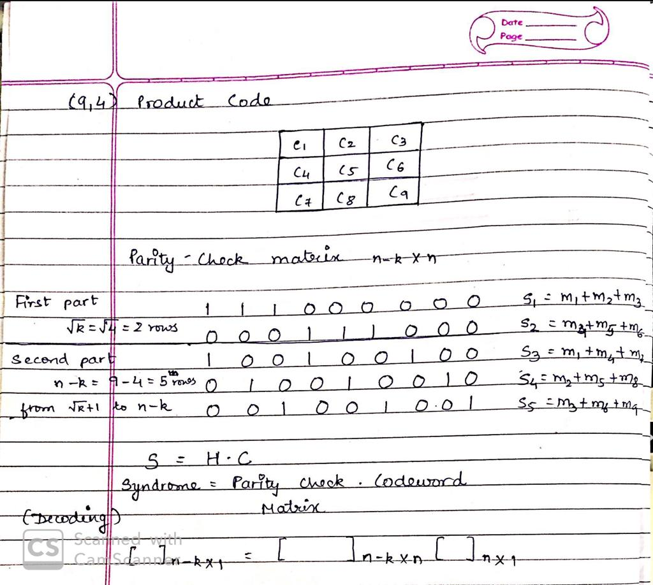
Parity Check Matrix (for product code)
Firstly, we initialize Parity Check Matrix of dimension(N-K)*N.
In Parity Check Matrix, if the message node is connected with corresponding checknode then it is denoted as 1 in parity check matrix.

Slide 9
LDPC Code
LDPC code are known as Low Density Parity Check Code. In LDPC code, unlike the product code, the parity check matrix is given as input by user. In LDPC code, the percentage of 1’s in the parity check matrix is low.
Irregular LDPC code consists of unequal row and column distribution. For example unequal number of check nodes are connected with message node.
While for regular LDPC, the row weight is equal for all rows and column weight is equal for all columns. For e.g, each message node is connected with equal number of check nodes and vice versa.
For regular LDPC code, if number of rows are N and columns are M and row weight is wr and column weight is wc then-
N*wr=M*wc

Slide 10
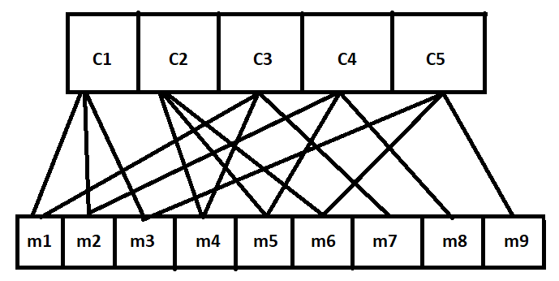
Understanding Of Tanner Graphs
Before going on for decoding, we first need to see what tanner graphs look like.
In tanner graphs, the variable node and check nodes are connected to each other virtually.
Visualization Of Tanner Graph

Slide 11
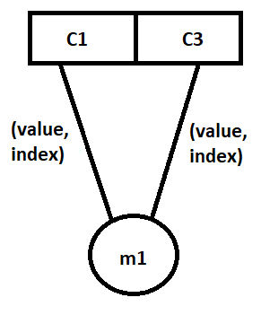
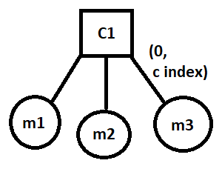
Message passing Algorithm
Firstly, the check nodes are updated by the values of variables nodes connected to it. In our code, we have used vector instead of array for making code efficient.
In the code, a pair of values have been passed to respective connected check node. The pair contains two parts- the value carried by the variable node connected to it and its index number.
While on the other hand, the message node contains the index number of the check node to which it is connected.

Slide 12
Decoding for BSC channel
For making the “maj” matrix, we have taken XOR of all values present in respective check nodes except for which the XOR is to be taken. For making maj matrix, 2D vector is used to make it memory efficient
For e.g.- if we want to take XOR for (v1) from (c1) then we will take XOR of each value from the check node (c1) except (v1).
This process is continued till we get all values of maj matrix from the check node matrix.
Each maj matrix element contains two values as pairs: the first value contains the index of checknode from which the XOR is obtained and second value contains the XOR value.

Slide 13
After making the maj matrix, for updating the values in check node matrix value v1 in c1, we will take majority of the elements present in maj matrix row 1 and received message code except the maj matrix element (c1,v1).
Continuing this process, we will get updated values of alpha matrix.
While for counting the value of H*C we will take majority of all beta matrix element and received message.
If H*C is zero for all checknode of dimension (N-K)*1, then we have successfully decoded the received message and break the loop else continue the loop till we successfully decode it.
After some iterations, if the message is still not decoded then we will exit the loop even though the message is not decoded,

Slide 14
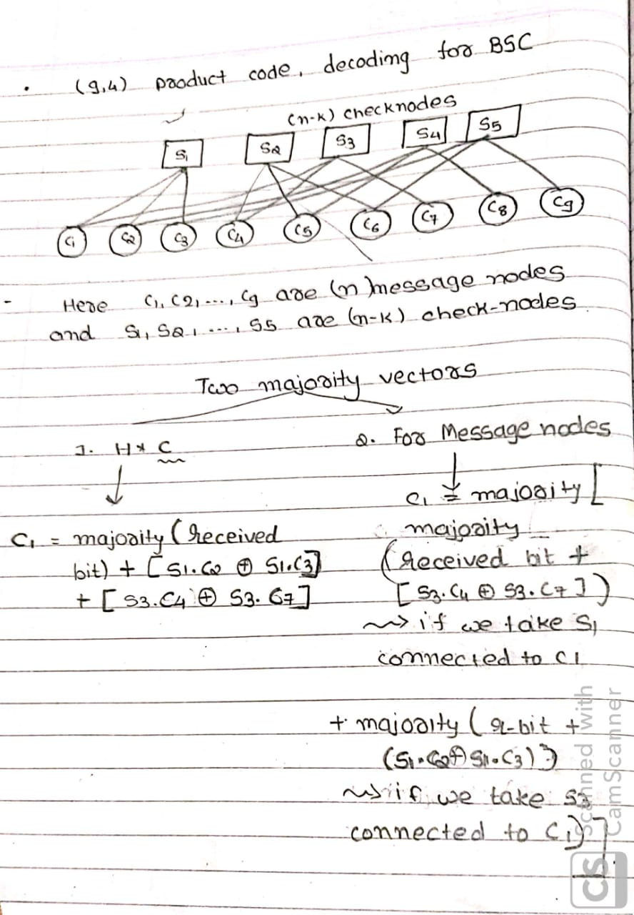

Slide 15
Decoding for BEC channel
The message passing algorithm for BEC decoding remains same as for BSC decoding. However for the erased bits we have taken (-1) as value to be passed to checker node.
As described above, while taking XOR if (-1) is encountered then (-1) is passed. However even if any other value other than (-1) is obtained, then we consider it as the correct value and assign it to its all connected checknode.
In our code, we also keep track the number of erasures after each iteration so that if erasures becomes zero then we exit the loop. After some number iterations, if erasures are not recovered then we stop the code without successful decoding.

Slide 16
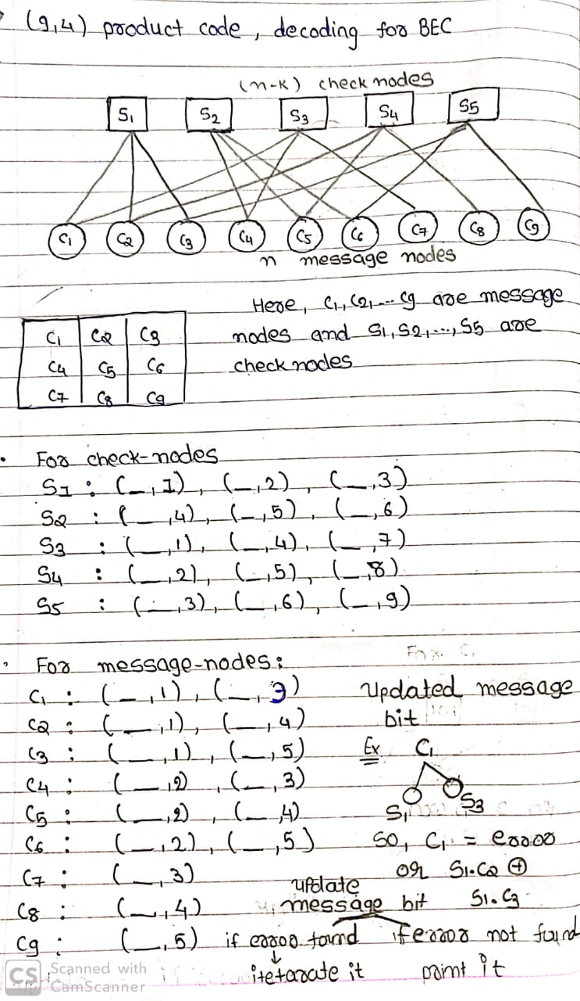

Slide 17
GRAPHS

Slide 18
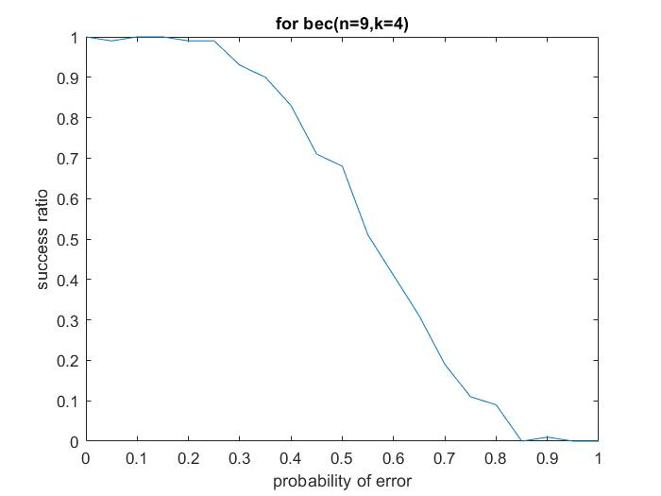
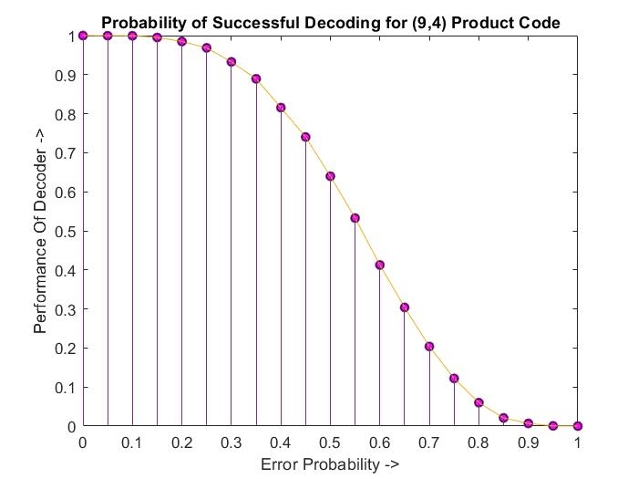

Slide 19
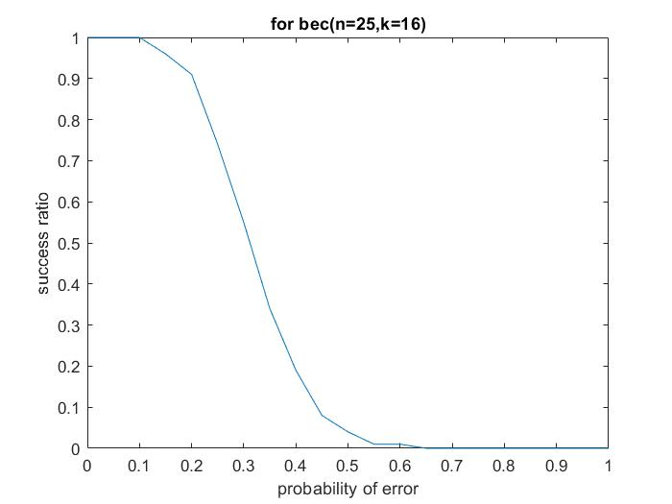

Slide 20
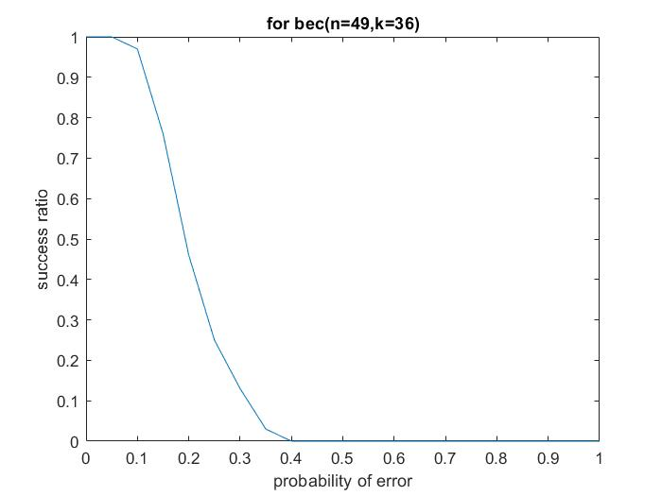

Slide 21
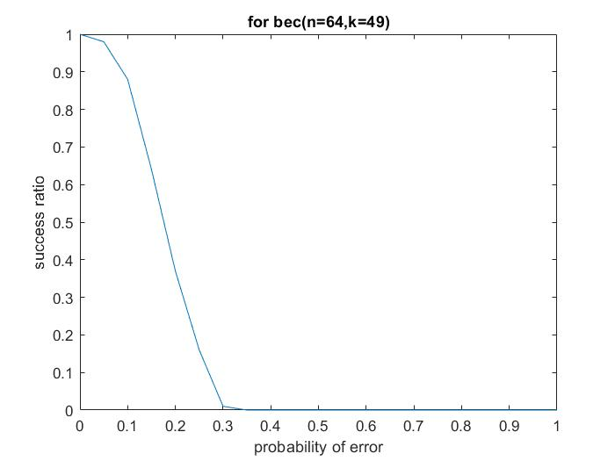

Slide 22
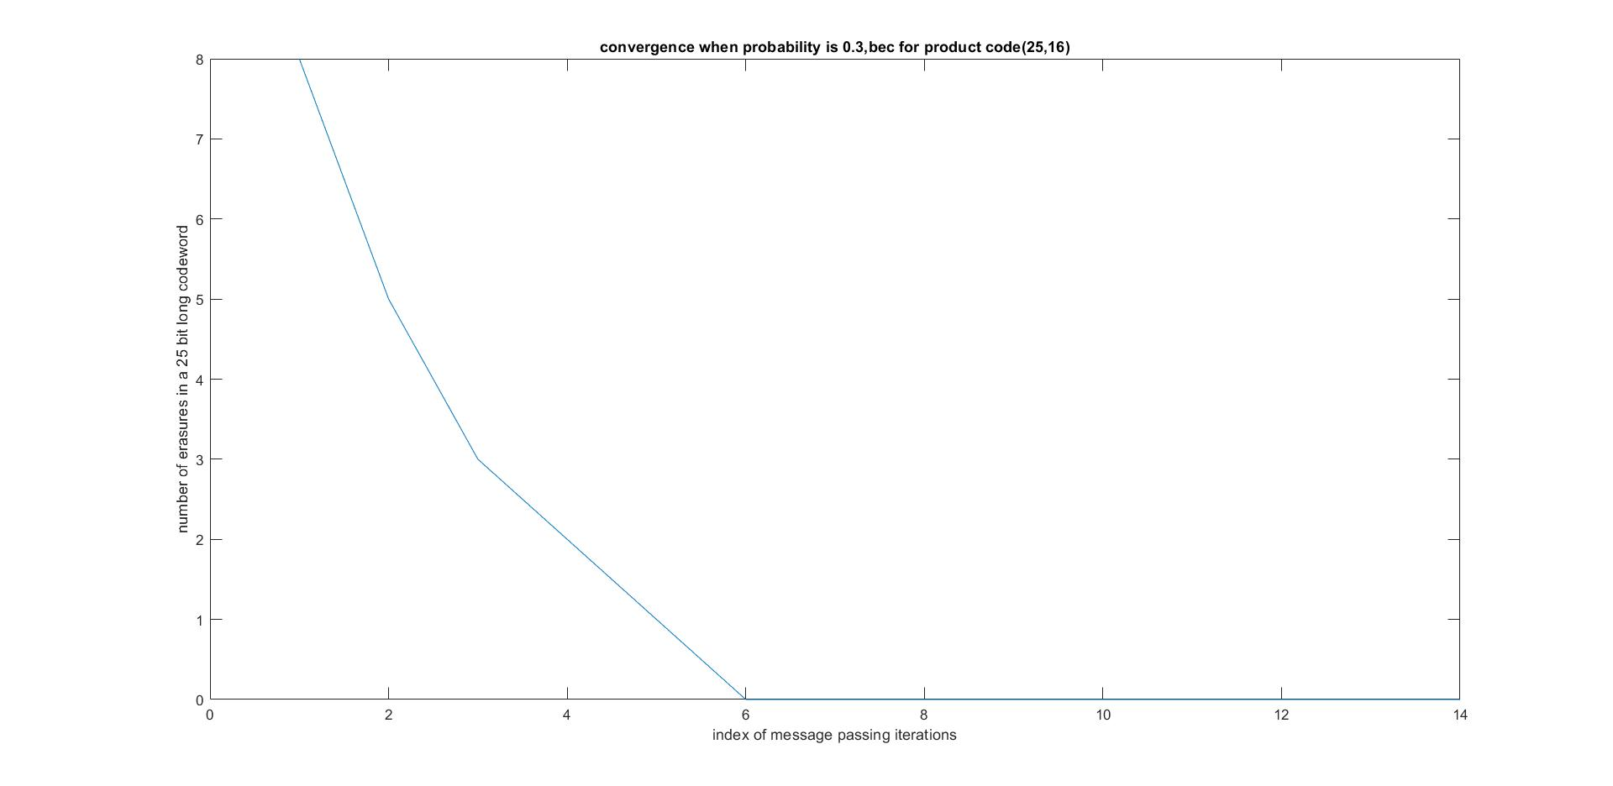

Slide 23
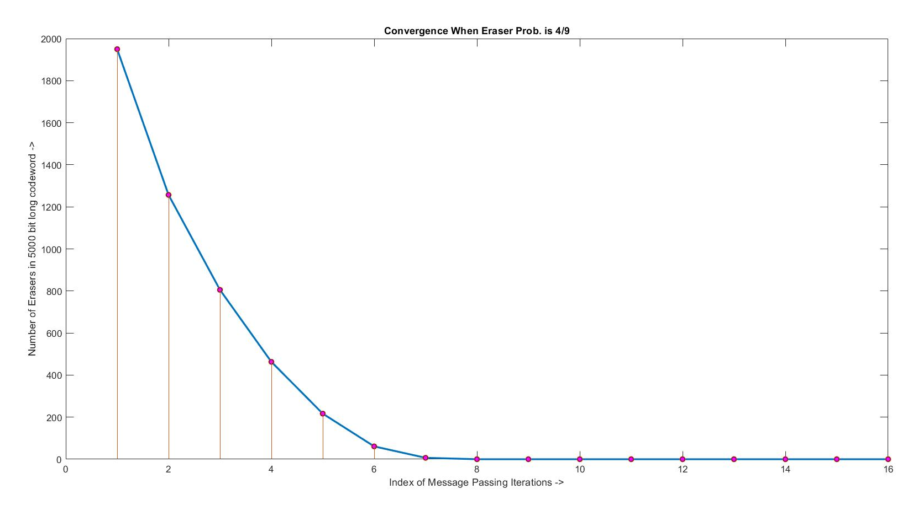

Slide 24
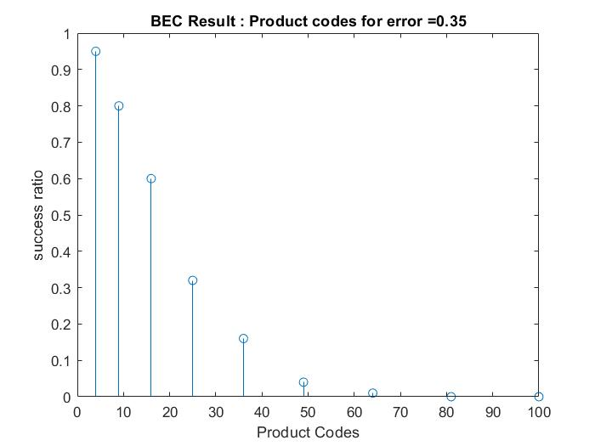

Slide 25
Analyzation of Graphs
FOR BEC Channel-
For BEC product code, as N i.e. as number of total message bits including parity increases, the probability of solving erasure error decreases.
Also if probability is increased for erasing the message bits, the probability of solving erasure error decreases.
One noticing point about the BEC code which is not seen for BSC code is that error solving after each iteration always decreases or remains the same but does not increases.

Slide 26
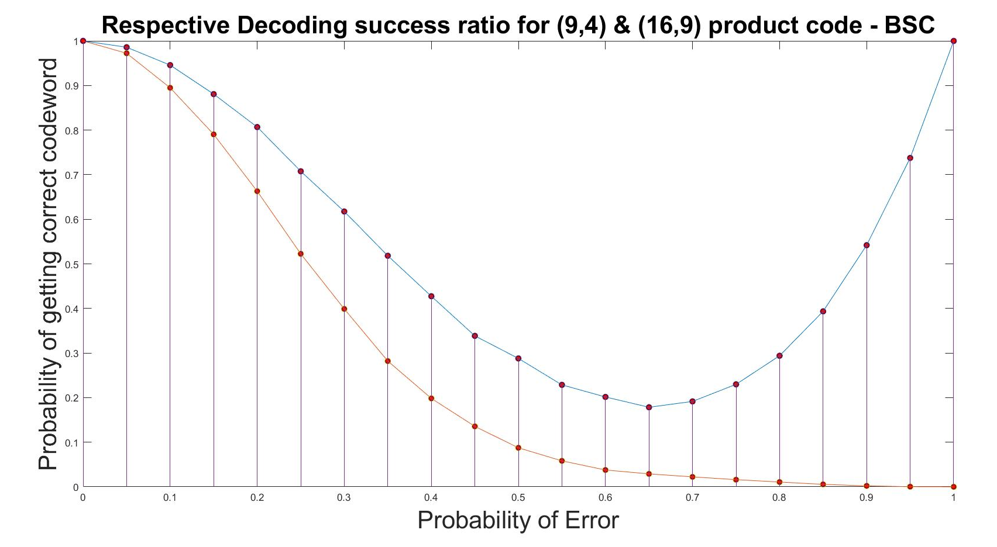

Slide 27
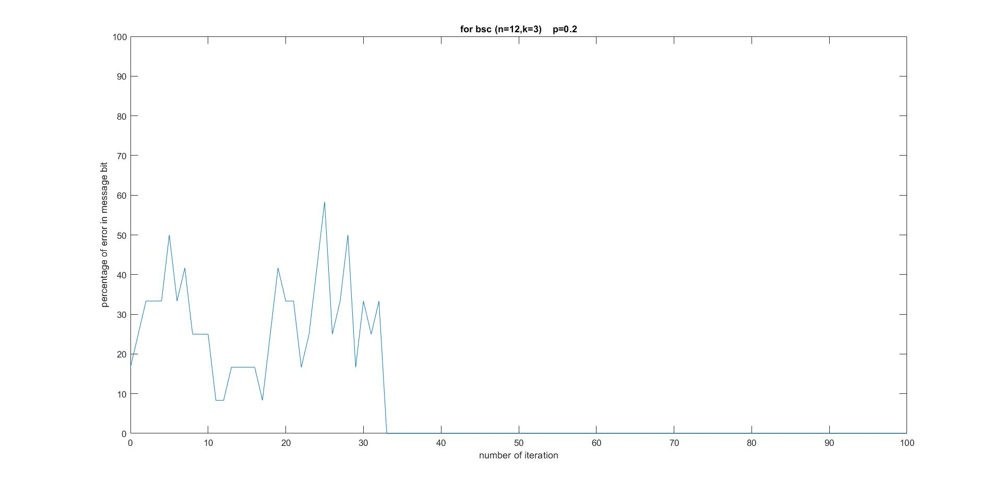

Slide 28
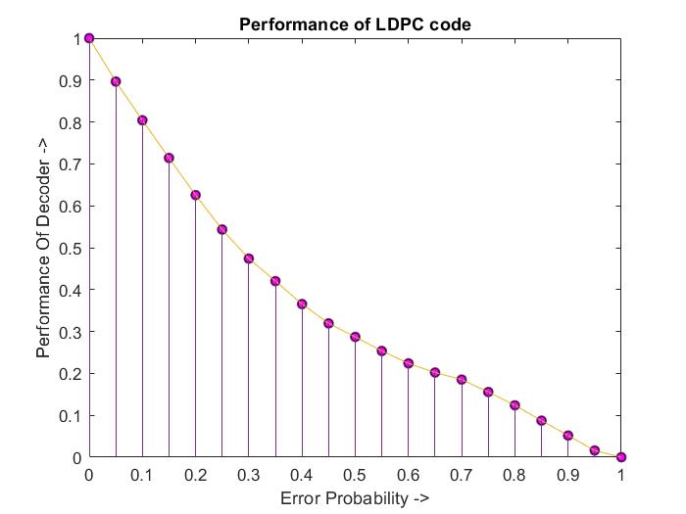

Slide 29
Analyzation of Graphs
FOR BSC Channel-
For BSC channel, there is such a trend that with each iteration the errors may increase, decrease or may also remain the same.
Also, as probability of flipping increases, the probability of error solving decreases.
The “U” graph can be explained as- if sqrt(n) is odd then on making flipping probability as closer to 1, the probability of solving error increases and if sqrt(n) is even then the conventional graph follows.

Slide 30
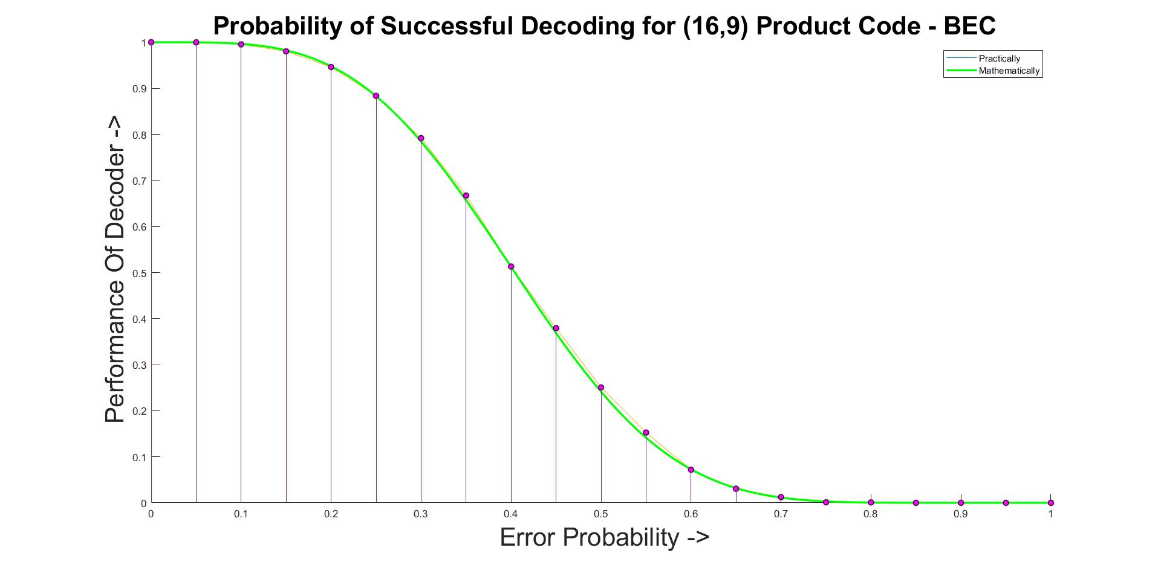
Monte Carlo Theoretical and Simulation Analysis

Slide 31
Summary And Future Work
The process we did is known as Hard Decoding. Though the Hard Decoding is efficient, the more efficient is Soft Decoding which we were unable to make due to some constraints. In future, if we can get a chance again, we might try our hands on it too.

Slide 32
Thank You

